Slide 1

Lesson: 1.1
Icebreakers and Getting Started

Slide 2
Lesson Objectives
You should be able to...
1. | Create a project in Unity
2. | Create and manipulate primitives
3. | Create and assign materials to objects

Slide 3
Key Terms - 1
Hierarchy | Lists all of the GameObjects in our open scenes in hierarchical order.
Inspector | A Unity window that displays information about the currently selected GameObject, Asset or Project Settings, allowing you to inspect and edit the values
Game View | A Unity window that displays the game from the vantage point of the player.
Scene View | A Unity Window that show the game in an editing mode, where the user can select, arrange and manipulate Game Objects
Project Files | A Unity Window that holds and manages all the files associated with the game.

Slide 4
Key Terms - 2
Primitive | Basic geometric forms.
Position | Where a GameObject is placed in a scene, using the X, Y and Z coordinates.
Scale | The size of an object with X as the width, Y as the height, and Z as the depth.
Rotate | The circular movement of an object around the X, Y, or Z axis.
Transform | Changing the Position, Scale, or Rotation of a GameObject

Slide 5
Introduction
Getting to know each other

Slide 6
Getting to Know You!
When it is your turn, please share the following:
Your Name
Where you’re from
Your programming experience
Your favourite game
👋
Notes:
Emphasize the similarities between the students. Get them to connect about things they enjoy or love doing. Tell students that everyone is here to learn, everyone needs support and they should work as a team to get themselves through this course.

Slide 7
Hook
Your Game Development Team

Slide 8
Getting to Know Your Team!
Expand the conversation. It’s important to relate well to one another and find commonalities. This will help build a more cohesive and collaborative team environment. Start with your favorite game and have discussions about the following:
What make for a great video game? Is it the graphics, the game play, or the story line?
Have they ever beaten a full game, which ones, and how long did it take?
Are there games they have given up on? Why did they stop? What makes a game no longer worth playing?
What kind of ideas do they have for making a game? Is it simple, or really involved?
Most video games require a whole team of programmers and modelers, and often take years to make. Finding other like minded video game developers you can collaborate with is essential to being a successful game developer. Are some of those people in this class with you?

Slide 9

Unity
Unity = industry-standard Game Engine, and usually the first choice for developers working with either mobile games or VR and AR
Examples of games developed in Unity: Temple Run, Plague Inc, Gone Home, Kentucky Route Zero, Rust, Surgeon Simulator, Hitman GO, The Long Dark, Wasteland 2, Kerbal Space Program, Pillars of Eternity, Pokemon GO, Super Hot, Subnautica, Accounting.
Source: https://unity.com/

Slide 10
Instruct
Getting started with Unity

Slide 11
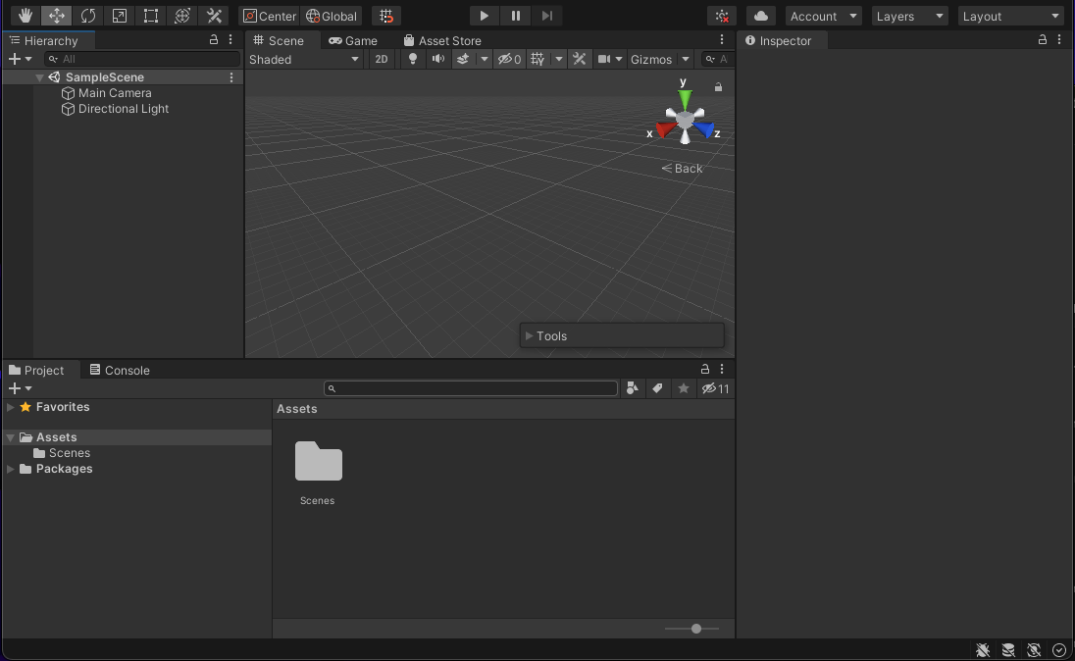
Our First Scene - 1
When you first open Unity, it will probably look like this:
Notes:
Some students may be in ‘light mode” versus ‘dark mode’. Dark mode is shown throughout this course.

Slide 12
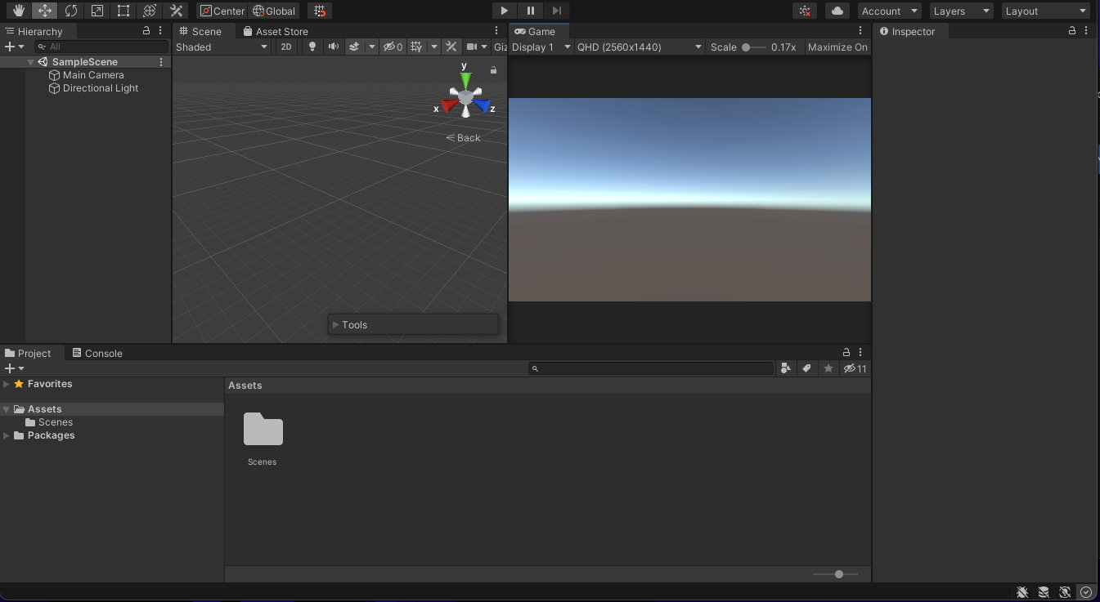
Our First Scene - 2
Rearrange it slightly, like the following:
Drag the game panel next to the scene panel so you can see both at once, and change the resolution from Free Aspect to 16:9.
This will help you keep everything lined up properly.
Hierarchy
Scene View
Game View
Inspector
Project Files
Notes:
It’s a good idea to practise moving the panels around. Show students how to customize their workspace.

Slide 13
Our First Scene - 3
Project list: Lists everything in the actual project. Right click on Assets > Reveal in Finder to show how this reflects the file structure exactly.
Hierarchy: Lists everything in the current scene. Show how the SampleScene comes with a Main Camera and a Directional Light.
Inspector: Shows the components and variables attached to each GameObject. Highlight the Camera and the Directional Light in the Hierarchy, to show the different components attached to them.
Game View: Shows what the Main Camera is looking at, and what the final game looks like.
Scene View: Allows the developer to navigate around the scene, to change and move things.

Slide 14
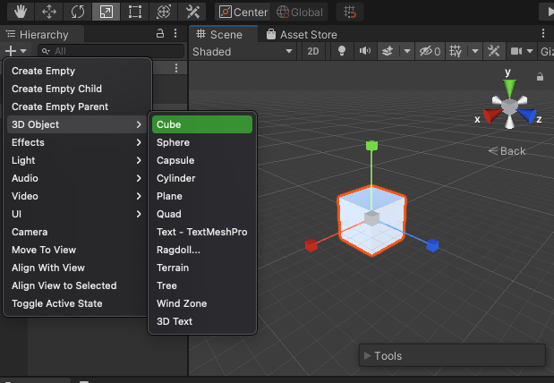
Creating a GameObject - 1
In the Hierarchy, select Create > 3D Object > Cube.

Slide 15
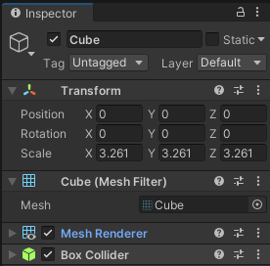

Creating a GameObject - 2
Find the gizmo in the top right corner of the scene view for axis reference.
Use the Cube to observe how the variables change in the inspector. Click and drag over X, Y, and Z properties, or enter type numbers in the fields and see the results in the scene view
Change the Position properties
Change the Rotation properties
Change the Scale properties
The inspector panel shows the attributes of the selected object. If no object is selected the inspector panel will be blank.

Slide 16
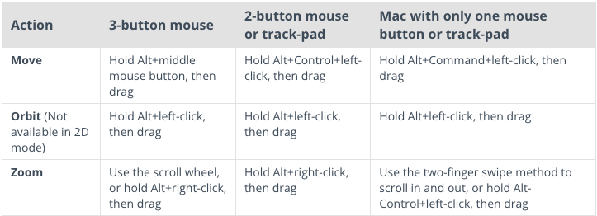
Moving Around in the Scene View
Now that we have an object to see as reference, let's learn how to move around in our scene view, and move our objects around manually, using the Gizmos.
MOVING IN SCENE VIEW:
Select an object in the scene view or the Hierarchy and hit "F." Now that object is in focus, and orbiting with orbit directly around that object.

Slide 17
Check-In
Moving, panning and zooming will help you grasp the X, Y and Z cartesian space and the 3D environment. Ensure you can Pan, Zoom and Orbit. Be able to identify which axis is red, green and blue.
Some developers may navigate around differently based on their own preferences and that’s okay.
Just make sure you don’t get lost or become too inefficient with your movements.
You can always double click an object in the hierarchy to focus their view on that object.

Slide 18
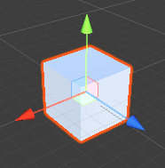
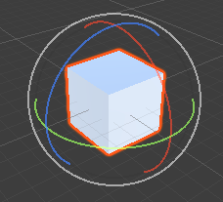
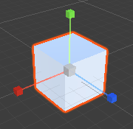
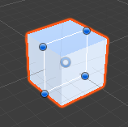
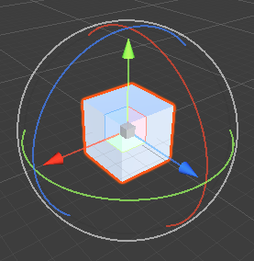
Manipulating Objects in Scene View - 1
Use Keyboard shortcuts to access the object tools.
Q
W
E
R
T
Y
W: Move
E: Rotate
R: Scale
T: Rect Scale
Y: Free Transform

Slide 19

Manipulating Objects in Scene View - 2
Note how the values change in the Inspector panel while the object changes
Click and drag the colored lines or end points to change the properties of the object. Each color represents an axis:
Y Axis: Green
X Axis: Red
Z Axis: Blue
Position
Rotation
Scale

Slide 20

Manipulating Objects in Scene View - 3
Zero Out the Transforms: Setting the attributes to 0
Position: 0, 0, 0
Rotation: 0, 0, 0
Scale: 1, 1, 1 (a scale of zero has no mass and therefore not visible)
This resets the object to its basic form and position.

Slide 21
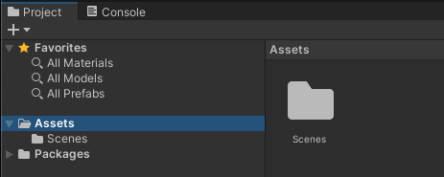
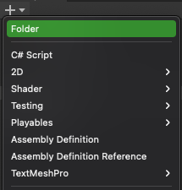
Creating Materials - 1
We can change the color of objects by creating and assigning materials.
In the Project panel navigate to the “Assets” folder.
Use the “+” to create a new folder and name it “materials”. This folder is where you should create and store all your materials. Double click this new folder to navigate inside it.

Slide 22
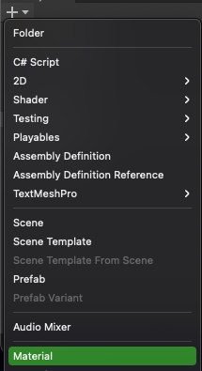
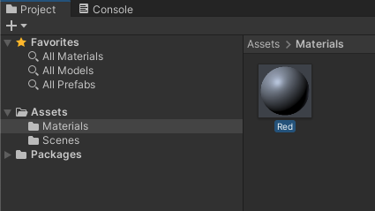
Creating Materials - 2
We can change the color of objects by creating and assigning materials.
Use the “+” (or right click in the blank folder) and select “Material” to create a new material asset.
Name this material whichever color you’d like to use. (i.e Red)

Slide 23
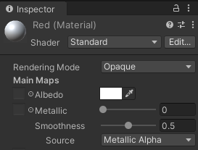
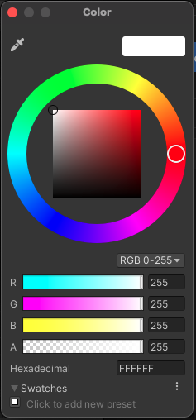
Creating Materials - 3
We can change the color of objects by creating and assigning materials.
Click on this new material in the project panel and the Inspector Panel to show its attributes.
Click the color square next to “Albedo” to pull up a color picker.
Mix a color in the color palette and this will be assigned to the material. Close the window when done.
Optionally, adjust the metallic and smoothness slider to affect the glossiness of the material.

Slide 24
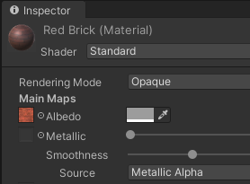
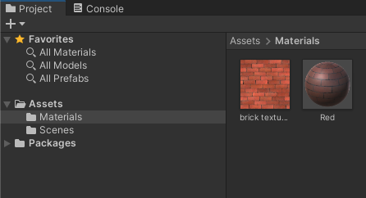

Creating Textures
You can also use images in your materials
Create a new material in the Project panel and name it accordingly.
Download an image file (seamless textures work best) and drag it into the Materials folder.
Once the image is in the Material folder, select the new material you just created.
Drag the texture image from the Project panel in the the square to the right of “Albedo”
Note: You can change how the image is tiled in the “Tiling” property
Drag images into your material folder
Notes:
Finding quality seamless textures can be difficult. Poor examples will cause objects to look artificial and repetitious. The best way to tell if a pattern will work is to observes the opposite edges and figure out if various elements will match up when tiled.

Slide 25
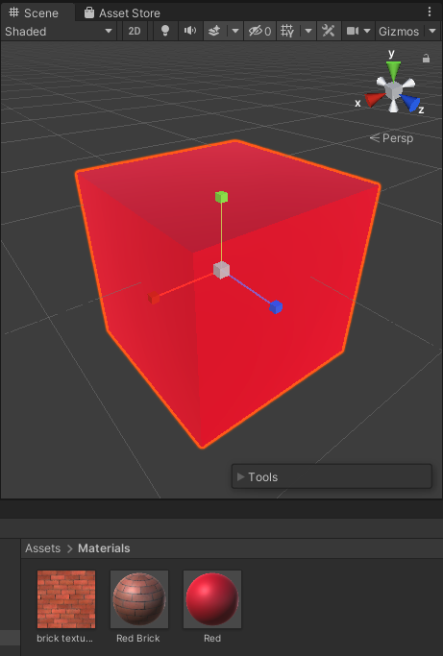
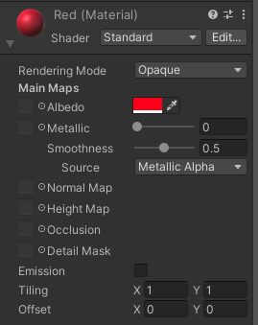
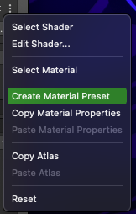
Assigning Materials
There are two ways to assign material to an object:
Drag your material from the Project Folder directly onto the object in the scene view. The benefits of this method is that you can assign the same material to many different objects.
OR - Select the object in the Scene View and directly manipulate the material attributes just as you did when you created a material. This material is unique to this object and not saved in your materials folder. If you want to save it, navigate to the 3 dots menu and select “Create Material Preset”

Slide 26
Explore
Your Turn!

Slide 27
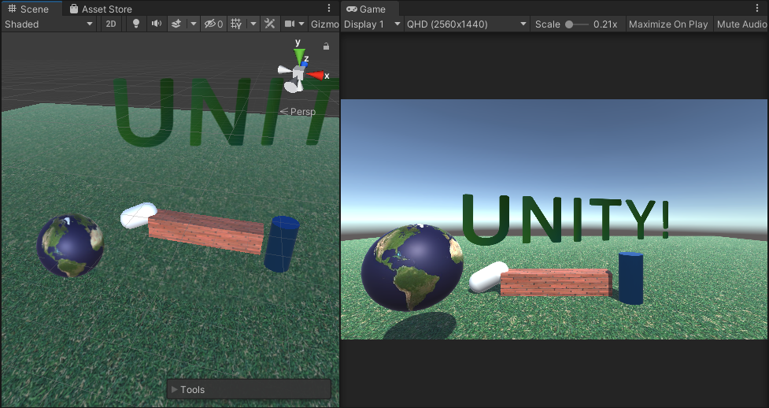
Scene Making
Create a scene for yourself. Focus on using different primitive objects to make some sort of landscape. Assign colors and materials as you’d like. In the next lesson you will learn how to create more complex objects (like people) so just focus on manipulating primitive objects at this point.
Try these other primitive objects:
Sphere
Cylinder
Capsule
Plane
Text

Slide 28

SAVE YOUR WORK!!!

Slide 29
Share and Reflect
Share Your Work

Slide 30
Share with the Team!
Share what you created.
Provide constructive feedback for each other, and encourage more additions.
This can be done verbally or through the chat.
Notes:
If another student made an especially awesome object or scene have them share how they made it with everyone else in the team.

Slide 31
Key Terms - Review
It’s important to review key terms from the lesson.
Try and define what these terms mean and describe how you used them in your game!
Hierarchy | Primitive
Inspector | Position
Game View | Scale
Scene View | Rotate
Project Files | Transform

Slide 32
Extension
Done Early?

Slide 33
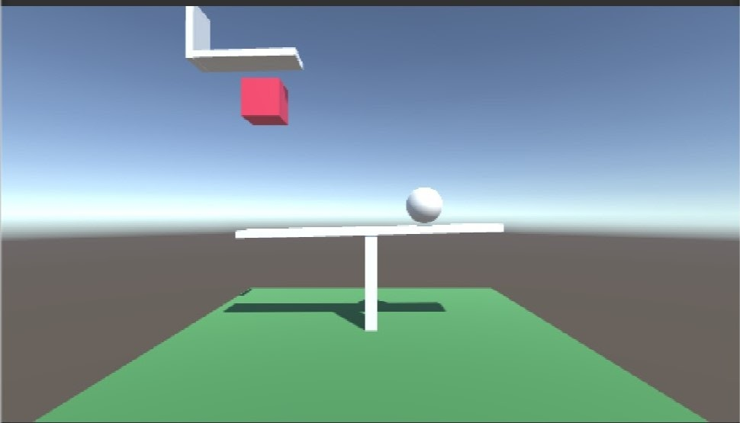
Extend your ideas
Medium - Challenge yourself by building something a little more interesting. Can you create a globe? Or a basketball? Can you build a structure like a building or a ramp?
Advanced - Try advanced 3D objects like Terrain, Tree and 3D text. This will require a lot more discovery.

